Slide 1





Home About Us Shop How It Works Contact FAQ’s
Logo
Vehicle Alerts – VA QR Code provides a fast and reliable way to Report any Incident or Get notified about your parked vehicle in Real Time via SMS or WhatsApp on your Cell Phone.
Messaging is 100% Private
Emergency Contact
Data Protection
Cost Effective
Peace of Mind

Slide 2
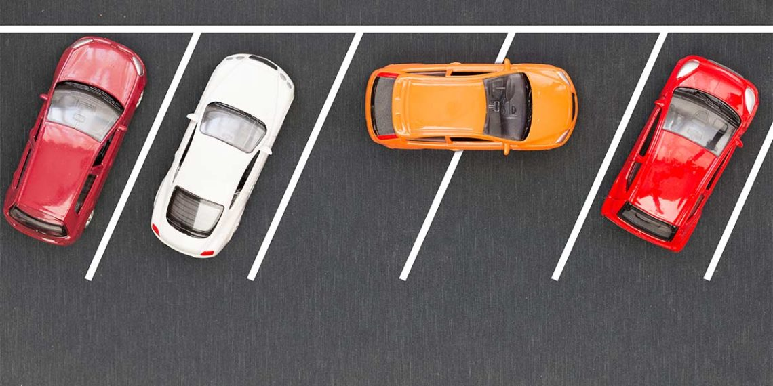

Home About Us Shop How It Works Contact FAQ’s
Logo
Worried about Nuisance parking?

Slide 3
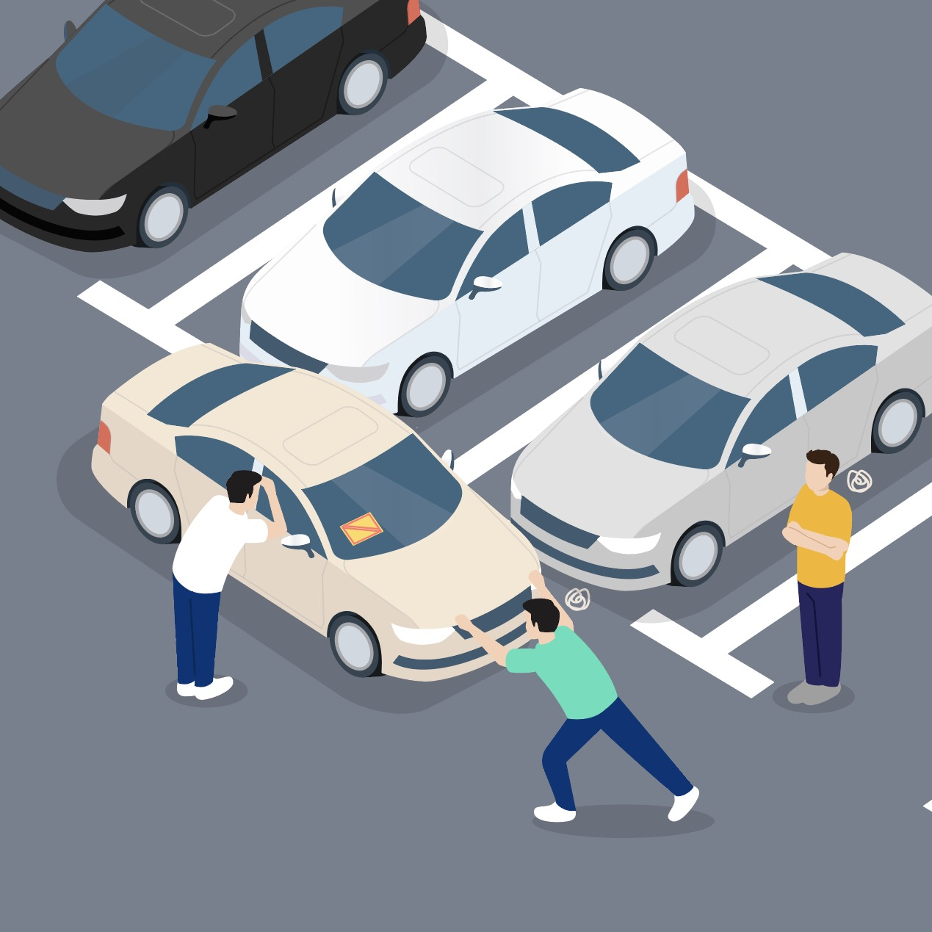
Home About Us Shop How It Works Contact FAQ’s
Logo
Worried about Nuisance parking?

Slide 4
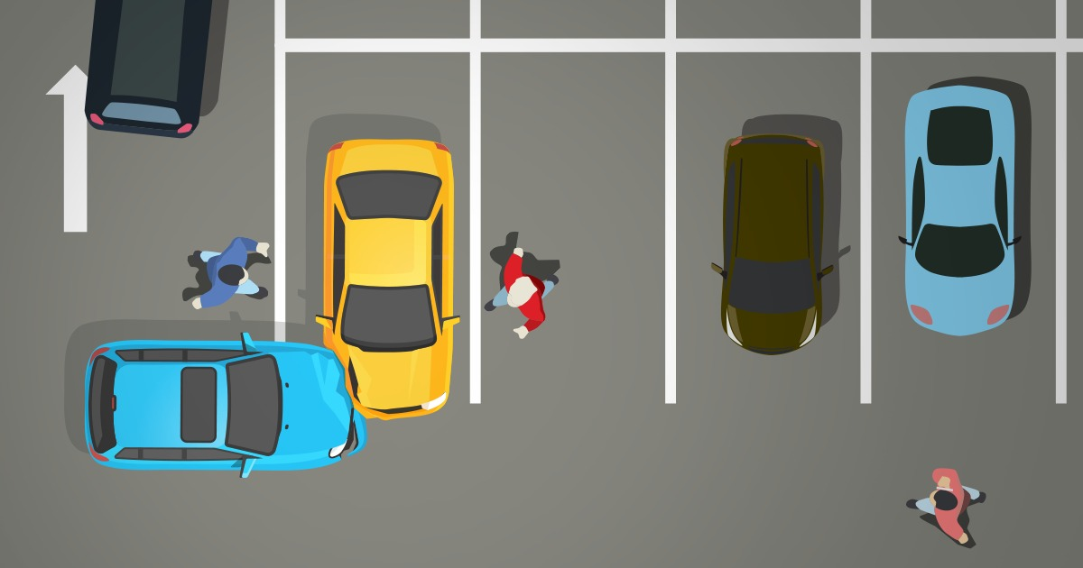

Home About Us Shop How It Works Contact FAQ’s
Logo
Someone Hit a Parked Car?

Slide 5



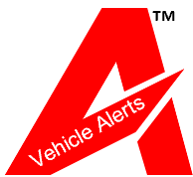


https://www.ayzanlabs.com/respoqrcode.html
Home About Us Shop How It Works Contact FAQ’s
Logo
Vehicle Alerts VA provides a fast and reliable way to Report any Incident or Get notified about your parked vehicle in Real Time via SMS or WhatsApp on your Cell Phone.
Messaging is 100% Private and anonymous
Wrong Parking / Vehicle Blocking
Left Car Lights On
Parked Within A Tow-Away Zone
Left Doors Open
Road Accident
Left Baby in the Car
Flat Tire
Windows Open

Slide 6

Home About Us Shop How It Works Contact FAQ’s
Logo
About Us
Welcome to Ayzan Trade Tech Pvt Ltd [Ayzan Labs], a cutting-edge IT solutions provider driven by innovation and expertise. With a commitment to delivering exceptional results, we bring together a team of skilled professionals and forward-thinking entrepreneurs to redefine possibilities in the digital landscape.

Slide 7

Home About Us Shop How It Works Contact FAQ’s
Logo
Our Expertise
Backed by a diverse team of IT specialists, we excel in software development, cloud solutions, data analytics, artificial intelligence, and cybersecurity. Our proficiency is not just in keeping up with industry trends but in setting them, ensuring that our clients stay ahead in an ever-evolving technological landscape.

Slide 8

Home About Us Shop How It Works Contact FAQ’s
Logo
Why Choose
Innovation
We embrace the latest technologies and methodologies to create solutions that stand out in the market.
Collaboration
Our team works seamlessly to understand your unique needs and collaboratively develop tailored solutions.
Reliability
With a track record of successful projects, we are a trusted partner in your journey to digital transformation.
Results-Driven
Our focus is on delivering tangible, measurable results that contribute to your business success.

Slide 9

Home About Us Shop How It Works Contact FAQ’s
Logo
Our Misson
To empower businesses through transformative technology solutions, fostering growth, efficiency, and resilience in the digital era.
Let's Transform Together
Embark on a journey of digital evolution with Ayzan Labs. Together, let's turn challenges into opportunities, and aspirations into achievements.
Contact us today to discover how we can elevate your digital experience.

Slide 10
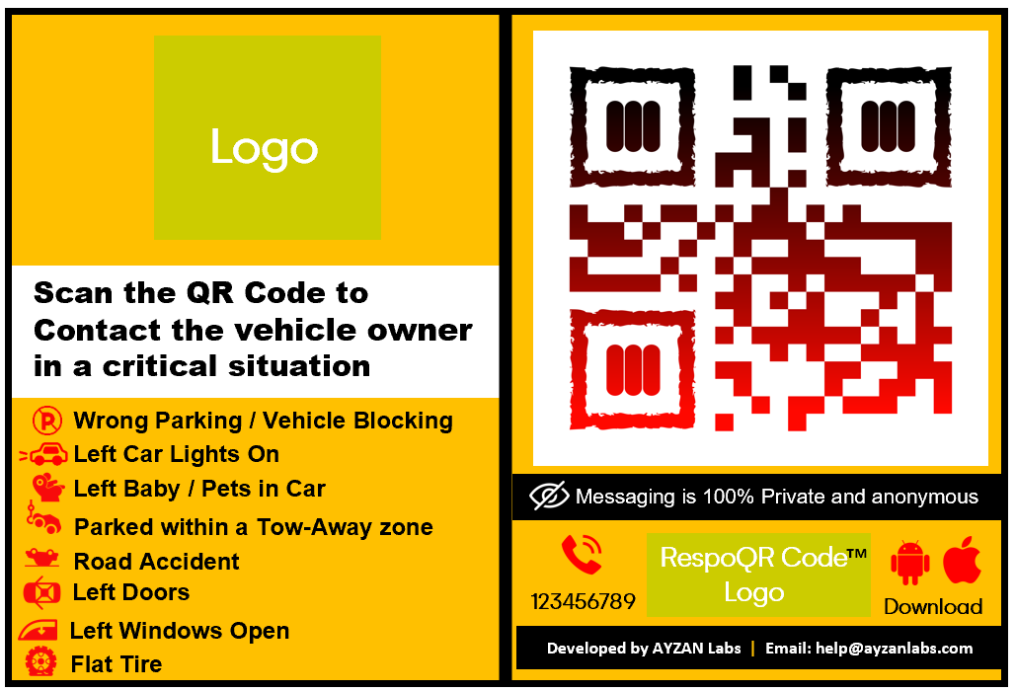




Home About Us Shop How It Works Contact FAQ’s
Logo
The first-of-its-kind Mobile app in the Country
Shop RespoQRCode Products
™
We offer a range of products and services under the RespoQRCode that can help the community stay connected to their Belongings.
™
Live Support
We are often concerned about our vehicle when we go for a drive and park it somewhere. We never know what’s happening to our vehicle when we park it somewhere and walk away.
VA mobile app helps a user to stay connected to their vehicle always. With this app, people can notify owners/users when their vehicle requires an attention, without disclosing any personal details of either party.
BUY NOW
Partners Corner

Slide 11






Home About Us Shop How It Works Contact FAQ’s
Logo
Login
™
In stock
Mobile Number*
Shop RespoQRCode Products
™
Password*
Remember me
Sign In
We offer a range of products and services under the RespoQRCode that can help the community stay connected to their Belongings.
™
Forgot password?
Register now
or
Live Support
LOGIN WITH FACEBOOK
We are often concerned about our vehicle when we go for a drive and park it somewhere. We never know what’s happening to our vehicle when we park it somewhere and walk away.
LOGIN WITH GOOGLE
LOGIN WITH TWITTER
VA mobile app helps a user to stay connected to their vehicle always. With this app, people can notify owners/users when their vehicle requires an attention, without disclosing any personal details of either party.

Slide 12





Home About Us Shop How It Works Contact FAQ’s
Logo
Sign up
Enter name*
Password*
Confirm Password*
Enter email*
Live Support
Mobile number*
Enter OTP*
By clicking Sign up, you agree to “AYZAN LABS VEHICLE ALERTS' Terms of Services and Privacy Policy.
Sign up

Slide 13







Home About Us Shop How It Works Contact FAQ’s
Logout
Logo
How does it work
No more car notes on the Windshield
Live Support
Download VA App
New account
Number Privacy
Buy VA Sticker
Download the VA App according to your mobile (iOS /Android)
Create your account with a username and password.
Messaging is 100% Private and anonymous.
Buy once VA sticker for the Lifetime.
Get VA via SMS
Emergency Call
Scan VA QR Code
Discount Offers
Start Receiving VA SMS on your parked Vehicles.
Add emergency contact details to receive a call.
Scan the VA QR Code to send a message to the vehicle owner.
Get notifications on
Special offer and discount

Slide 14







Home About Us Shop How It Works Contact FAQ’s
Logo
We are here to help!
Any questions or remarks? Just write us a message !
Name
Email
Enter your name
Enter your email address
Submit
Live Support
Follow us
Nagpur
International
+91-123456789
wecare@ayzanlabs.com
Facebook
Instagram
Twitter
©2023 Ayzan Trade Tech Private Limited, All Rights Reserved

Slide 15






Home About Us Shop How It Works Contact FAQ’s
Logo
FAQ’s
We are here to help!
Getting Started
My Account
Error
Messages
Live Support
Set
Reminders
Emergency Contact
Vehicle Registration
Didn't find an answer to your question, we are here to help
Contact us
Back to FAQ’s

Slide 16



Home About Us Shop How It Works Contact FAQ’s
Logo
FAQ’s
Getting Started
Here you’ll find information about Getting Started.
For Apple mobile
1. Click on the App Store Icon.
2. Click on the Search icon
3. Type Vehicle Alerts to download.
4. Go back to your mobile Dashboard and start using it.
Live Support
For Android mobile
1. Click on the Google Play Store icon.
2. Click on the Search icon
3. Type Vehicle Alerts to download.
4. Go back to your mobile Dashboard and start using it.
Didn't find an answer to your question, we are here to help
Contact us
Back to FAQ’s

Slide 17

Home About Us Shop How It Works Contact FAQ’s
Logo
FAQ’s
My Account
Here you’ll find information about My Account.
Change of Name
If you want to change your First name or Last name, you can do it from the app.
Go to MY ACCOUNT under the app menu
Tap the Name field to edit.
Tap Save after editing and your name will be updated.
Live Support
Forget password
If you have forgotten your password, tap on the Forgot Password? link on the Login screen.
Enter your registered mobile number to which One Time Password (OTP) will be sent.
On the Verify Mobile screen, enter the OTP/Verification Code.
Verify your mobile number and proceed to create a new password.
Remember that your password should contain a minimum of six characters.
Didn't find an answer to your question, we are here to help
Contact us
Back to FAQ’s

Slide 18
Home About Us Shop How It Works Contact FAQ’s
Logo
FAQ’s
My Account
Here you’ll find information about My Account.
Reset Password
If you want to reset your password.
Go to MY ACCOUNT under the app menu.
Tap the PASSWORD field.
In the RESET PASSWORD screen enter your current password and the new password.
Tap Save and your password will be updated.
Live Support
Change Mobile Number
Go to MY ACCOUNT under the app menu.
Tap the MOBILE NUMBER field to enter your new number and click to Save.
You will receive the OTP on your new mobile number. You will be asked to verify the One Time
Password (OTP) to update your new mobile number in the system.
Didn't find an answer to your question, we are here to help
Contact us
Back to FAQ’s

Slide 19

Home About Us Shop How It Works Contact FAQ’s
Logo
FAQ’s
Error Messages
Here you’ll find information about Error Messages.
Mobile number already existing
During the new registration, if you are receiving an error message “Mobile number already existing” it could be because there is an existing account with this mobile number. You can sign in with a new number and proceed with Forgot Password option.
My Account is Blocked
Live Support
Every individual has the right to feel safe and free from harassment. It may be because you send the wrong notifications to other vehicle contacts. People who violate the VA's guidelines may receive a warning or might get temporarily blocked for 24 hours.
(As per discussion, if the alternate number also does not respond, the case will be transferred to Traffic Police).
What makes a QR code unscannable?
If your camera not scanning the QR code, chances are, you're either trying to scan it in poor lighting or are either too close to the code or not close enough. You need to ensure you're at an appropriate distance from the QR code and have sufficient light. You can even ask someone to hold up a flashlight while you scan
Didn't find an answer to your question, we are here to help
Contact us
Back to FAQ’s

Slide 20

Home About Us Shop How It Works Contact FAQ’s
Logo
FAQ’s
Vehicle Registration
Here you’ll find information about Vehicle Registration.
Vehicle already registered
If you get this error message, it means the VA tag is already registered with some vehicle. Please submit a copy of your ID and Vehicle Registration ID to wecare@ayzanlabs.com to update your mobile number to re-activate the VA QR Tag. The administrative charges of Rs 100/- shall be applied.
Live Support
How many types of Notifications I can SEND ?
You can SEND notifications for the following reasons after scanning the QR Code of the parked vehicle
Wrong Parking / Vehicle Blocking
Left Car Lights On
Left Baby in Car
Parked Within A Tow-Away Zone
Road Accident
Left Doors Open
Left Windows Open
Fla Tyre (Tire)
Didn't find an answer to your question, we are here to help
Contact us
Back to FAQ’s

Slide 21
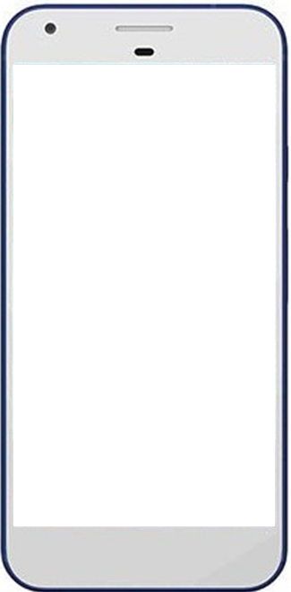






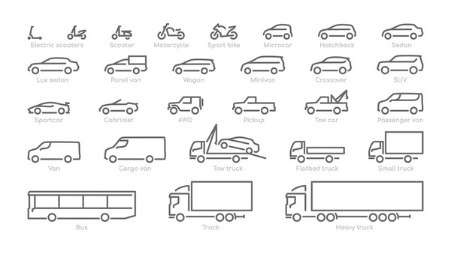




1
2
3
Logo
Live Support
Logo
Live Support
Logo
Mobile Number*_____________________
Create New Account
Enter Name*_______________________
Password*__________________________
Password*_________________________
Building better tomorrow –
Stay informed on your parked vehicle
Login
Forgot password
Confirm Password*_________________
Enter email________________________
Mobile Number*____________________
Biometric Authentication
Enter the OTP*____________________
Note for Developer: OTP must be Auto Enter
By clicking Sign Up, you agree to “AYZAN LABS VEHICLE ALERTS' Terms of Services and Privacy Policy.
Register
POWERED BY
Always obey the Traffic Laws
AYZAN Labs
Already a member? Click to Login

Slide 22


4
Logo
Create New Account
Enter Name*_______________________
Password*_________________________
Confirm Password*_________________
Success
Registration Part ends Here
Enter email________________________
Congratulations, Your account with VA has been successfully created
Mobile Number*____________________
Enter the OTP*____________________
Note for Developer: OTP must be Auto Enter
By clicking Sign Up, you agree to “AYZAN LABS VEHICLE ALERTS' Terms of Services and Privacy Policy.

Slide 23









1
Logo
Hi ABCD,
Welcome to VA, a safer community. Please add your Vehicles linked with your MOBILE number
Vehicle Registration Part ends Here
Vehicle Registration Country
Saudi Arabia
Plate Number
1 2 3 4
Digits in English *
١ ٢ ٣ ٤
Digits in Arabic *
A B J D
Alphabets in English *
ب
ح
١
د
Alphabets in Arabic *
١٢ ٣ ٤
١
١
١
1 2 3 4
A
A
A
Accept and Save
No belt, no excuse.

Slide 24




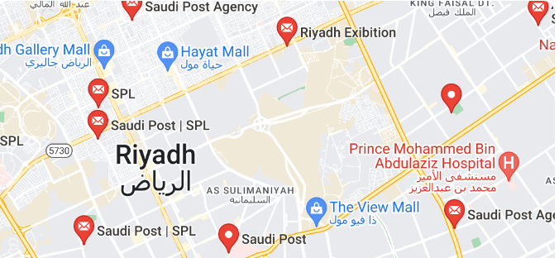






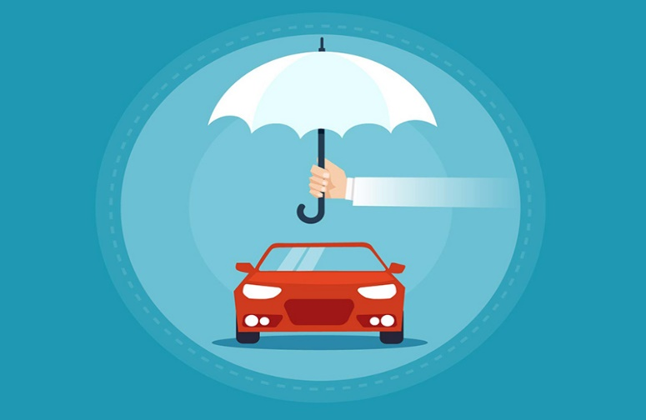





1
2
3
Hello, ABCD
Profile
ABCD
123456789
abcd@gmail.com
Full Name*_________________________________
Email*_______ _____________________________
Mobile Number*_____________________________
Welcome to Vehicle Alerts (VA) . Please add your Vehicles linked with your mobile number
Gender*
Profile Settings
Buy QR Code
Nationality*
Type Your ID number
Age *
FAQ’s
Contact Number -1*________________________
Contact Number -2*________________________
Advertisement Space Click to Buy
Primary Address*_____ _____________________
Support
Auto Detect the latitude and longitude for address
123, Riyadh Post Office,Riyadh-12345 Saudi Arabia
SET ADDRESS
Vehicle Insurance offers
About us
Save
Advertisement Space Click to Buy
Logout
Join hands for a safer community
Profile Update Part Start Here

Slide 25
4
Profile
Full Name*____________________________________
Email*_______________________________________
Mobile Number*_______________________________
Gender*
Nationality*
Age *
Profile Settings Part ends Here
Contact Number -1*____________________________
Contact Number -2*____________________________
Address*_____________________________________
Auto Detect the latitude and longitude for address
Change Password
New Password*_________________________
Confirm Password*______________________
Save
Exit
Join hands for a safer community

Slide 26


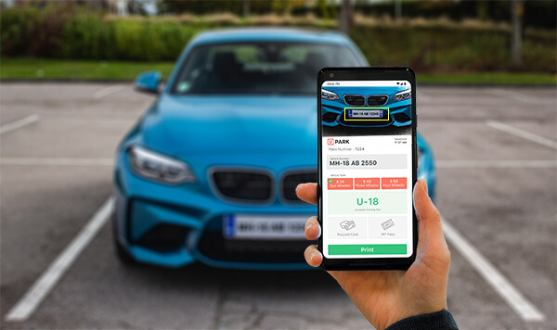
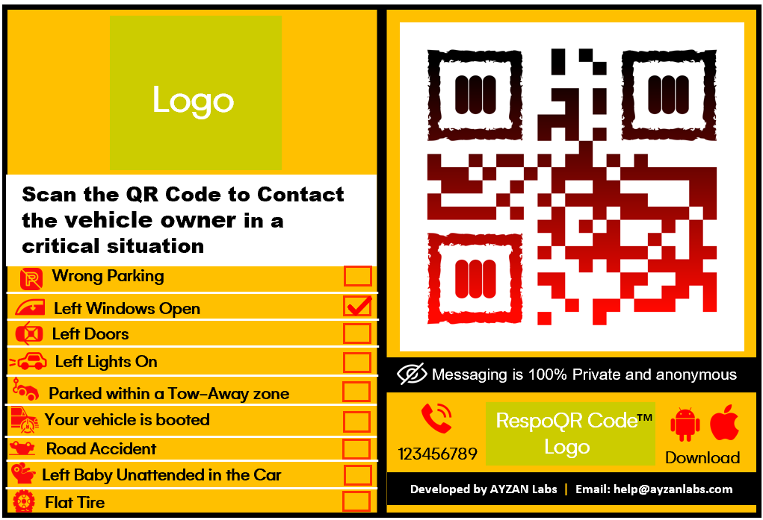





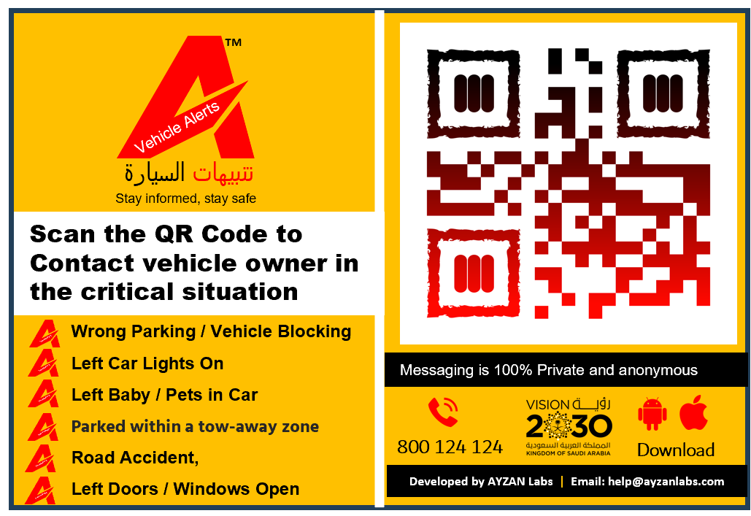


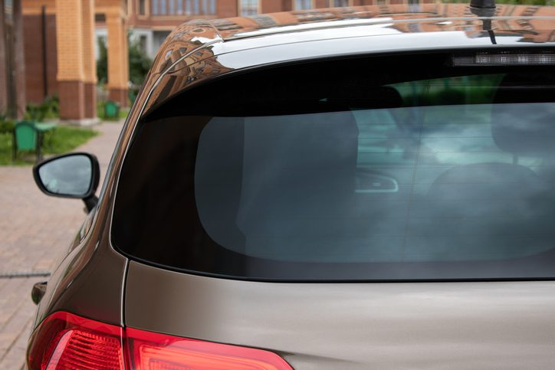
1
2
3
Hello, ABCD
ABCD
123456789
abcd@gmail.com
Welcome to Vehicle Alerts (VA) . Please add your Vehicles linked with your mobile number
Profile Settings
Buy QR Code
Type Your ID number
Scan
FAQ’s
Advertisement Space Click to Buy
Support
Vehicle Insurance offers
About us
QR Sticker
BUY NOW
Logout
Stay alert and connected with your vehicles. You will get notified instantly via SMS or WhatsApp on your mobile upon your vehicle requiring attention.
QR Code Sticker Material: Vinyl stickers are made for outdoor use and will withstand harsh weather elements. Safe and Non-toxic, Waterproof Snow protection and Anti-sun.
Advertisement Space Click to visit
Next

Slide 27






3
Home
Cancel
Share product with friends
Purchase Confirmation Window
Sticker Purchasing process ends Here
Email
Facebook
Instagram
Twitter
Success
Congratulations, We have received your payment. Your order has been created successfully. The confirmation will be sent out with Delivery OTP.
Advertisement Space Click to visit
Advertisement Space Click to visit

Slide 28

1
2
FAQ’s
FAQ’s
Please read carefully the information in this section. However, we do have sufficient staff capacity to respond to your query. Please WhatsApp +966 57 127 1237 or write on wecare@ayzanlabs.com
How can I send a notification to the vehicle owner in case of emergency on parked vehicle?
What does QR stand for?
Click on icon to scan the QR Code and select the reason why you want to contact the vehicle owner.
Quick Response Code
How many types of Notifications I can SEND ?
What is Vehicle Alerts QR Code Tag?
You can SEND notifications for the following reasons after scanning the QR Code of the parked vehicle
a. Wrong Parking / Vehicle Blocking
b. Left Car Lights On
c. Left Baby in Car
d. Parked Within A Tow-Away Zone
e. Road Accident
f. Left Doors / Windows Open
g. Threat for vehicle
Vehicle Alerts is a printable tag with a QR code that people can scan to message you in case there is an emergency with your parked vehicle, without having to reveal your contact information to them.
Error Message– Vehicle already registered
If you get this error message, it means the VA tag is already registered with some vehicle. Please submit your vehicle details from the Abshir website to VA Team wecare@ayzanlabs.com to update your mobile number to re-activate the VA Tag. The administrative charges SR 10/- shall be applied to re-activate the VA QR Code.
How many types of Notifications I can RECEIVE ?
You can RECEIVE a notification from another person for the above-mentioned reasons.
How many types of REMINDERS I can RECEIVE ?
What makes a QR code unscannable?
a. Reminder notification to your Vehicle Insurance expiry. b. Reminder notification to Vehicle Registration expiry. c. Reminder notification to Driving License expiry.
If your camera not scanning QR code, chances are, you're either trying to scan it in poor lighting or are either too close to the code or not close enough. You need to ensure you're at an appropriate distance from the QR code and have sufficient light. You can even ask someone to hold up a flashlight while you scan.

Slide 29


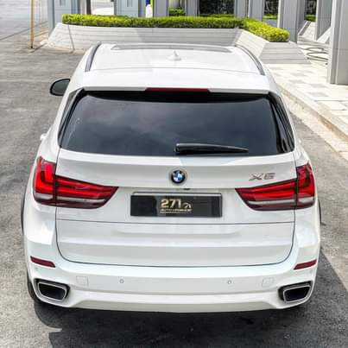
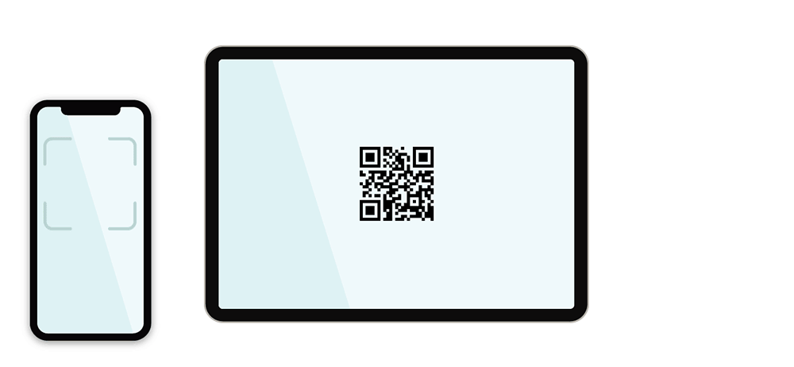





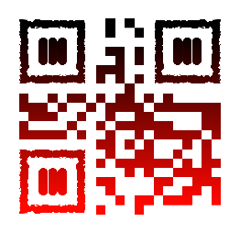





1
2
Sending Alert’s Starts Here
Contact Vehicle Owner
Contact Vehicle Owner
BCD5656
BCD5656
Select the reason for sending Notification
Scan QR Code
Wrong Parking
Left window open
Left Doors open
Left Lights open
Parked Within A Tow-Away Zone
Parked vehicle is booted
Accident
Unattended / Left Baby in Car
Flat Tire
send
Scan QR
We to need make something like this to show person scanning our QR code on his mobile.

Slide 30
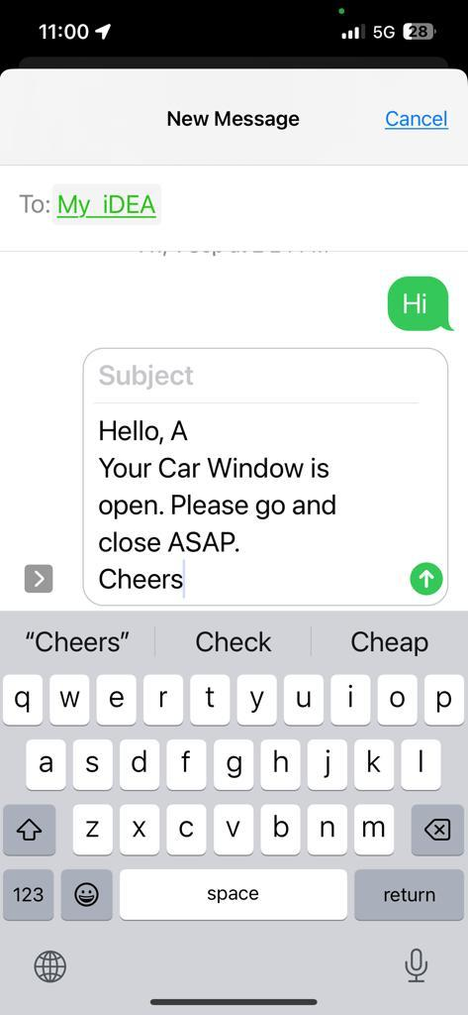
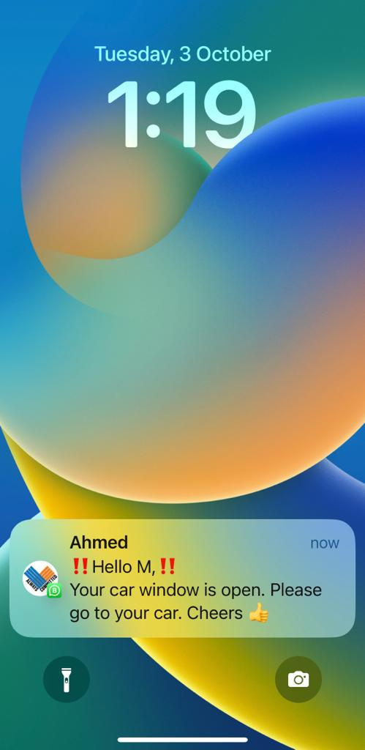
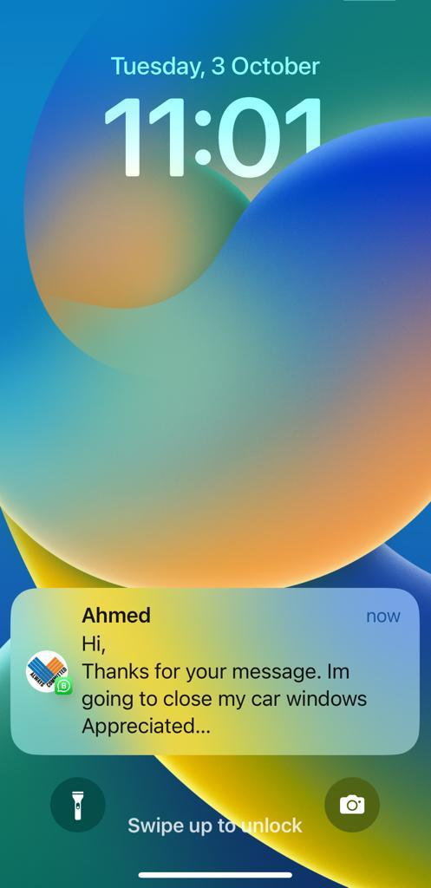
3
4
5

Slide 31
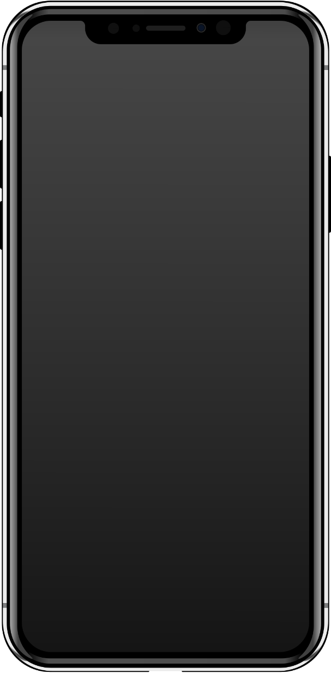
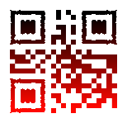

HOW WE PROVIDE YOU SECURE ALERTS
™
RespoQRCode is a service that allows you to create tags, each with a unique ID acting as a dedicated mobile number for the item it's attached to. These tags relay emergency messages to your actual registered mobile number without revealing it. When creating a new tag, you can opt to receive messages only from verified numbers. RespoQRCode verifies these numbers using a randomly generated code before relaying any messages. To prevent automated spam and block senders of false or improper messages, RespoQRCode employs a combination of IP logging, cookies, timestamps, human verification, and blacklists.
™
™
ORDER HERE

Slide 32
Branding Guidelines
FONTS
COLOR CODE
Gelion Regular
Gelion Light
Gelion Black
Gelion Meduim
Red : #F70B0B
Gray: #B1AFAF
White #FFFFFF

